Slide 1
Music Store Data Analysis
Overview
Questions for Analysing Music Store Data
Conclusion

Slide 2
Overview
To analyze the dataset using SQL to assist the Music Store in gaining insights into its business growth by addressing basic inquiries.
Database and Tools
Postgre SQL
PgAdmin4
Concepts used for this project
Aggregation functions like sum, average, count
Window functions
sub-queries
Common Table Expression(CTEs)
Joins: Self-join,Right join, Inner join

Slide 3
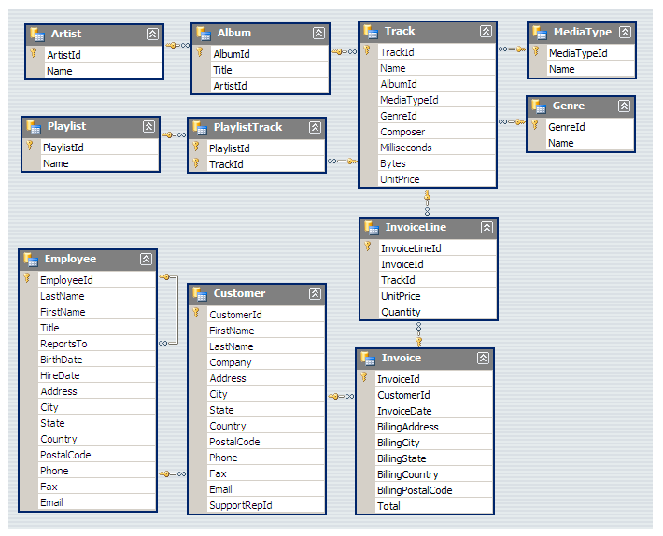
Schema- Music Store Database

Slide 4
Who is the senior most employee, find name and job title.
The senior-most employee holds the position of Senior General Manager, named Mohan Madan. Employee numbers are highest at the L1 level, but as seniority levels rise, the number of employees decreases progressively.

Slide 5
Which countries have the most Invoices?
The pivot table shows a direct correlation between the number of countries and the number of invoices, with most countries located in Europe. However, despite Europe having the highest number of countries, it is not the top region in terms of invoices generated; North America, particularly the USA, takes the lead in generating the most invoices. The USA significantly contributes to the invoice generation in North America.

Slide 6
What are top 3 values of total invoice?
The top three values in total invoices come from two countries: France and Canada.

Slide 7
Cities with top customers
These cities have the highest total invoices, making them strong candidates for hosting a successful promotional music festival that can generate substantial revenue.

Slide 8
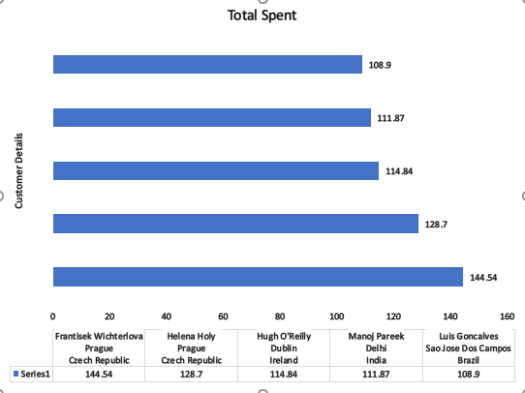
Top 5 Customers In terms Of Total Money They Spend

Slide 9
"Rock is a universally popular music genre in all countries except Argentina."
Most Popular Music Genre For Each Country In Terms Of Purchase
Rock is the only music genre which is popular in all country except Argentina.

Slide 10
TOP 10 Artist Who Have Written The Most Rock Music

Slide 11
Amount Spend By Customer On Artist (TOP 5 Customers)

Slide 12
Customer Spend Most On Music (TOP 5 Customers)

Slide 13
Conclusion
There are fewer employees at the senior level compared to the junior level.
The majority of customers come from Europe, accounting for approximately 70%.
Prague city generates the highest total invoice amount, and the top two spending customers are from this city.
Rock is the sole music genre popular in every country for purchases, except Argentina.
U2 is the artist with the most rock music compositions.

